Slide 1


Slide 2




CYBER
SECURITY
PRESENTATION
PRESENTED BY;- ANURAG KUMAR ROLL NO.; 261103
ARYAN RAJ ROLL NO.; 261089
B.TECH CSE
SECTION: B

Slide 3


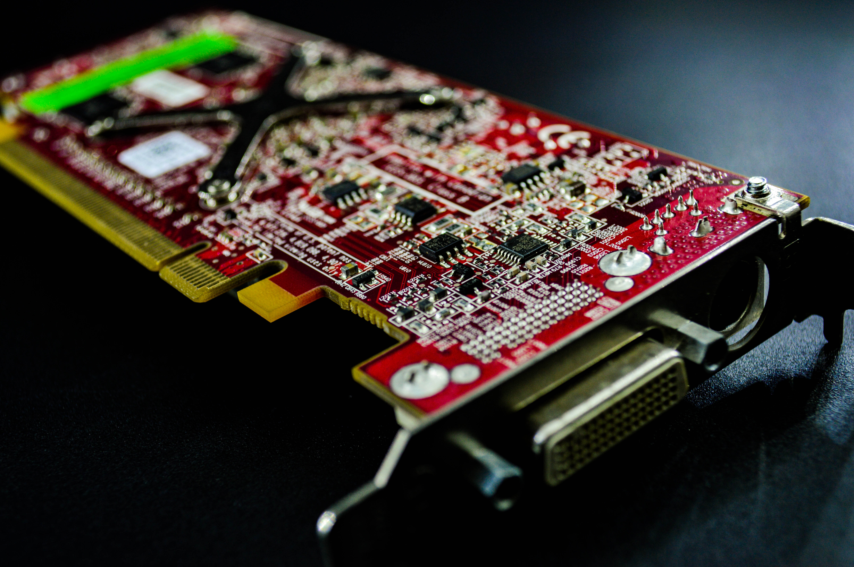
INTRODUCTION TO CYBER SECURITY
Cyber security is the practice of protecting systems, networks, programs, devices, and data from digital attacks, unauthorized access, damage, or theft. In our increasingly interconnected world, it plays a critical role in safeguarding personal privacy, financial assets, and critical infrastructure.

Slide 4


COMMON CYBER THREATS
Cyber threats encompass any circumstance or event with the potential to adversely impact an organization or individual's digital assets. Understanding how these threats operate is vital for building robust defenses and recognizing early warning signs.

Slide 5
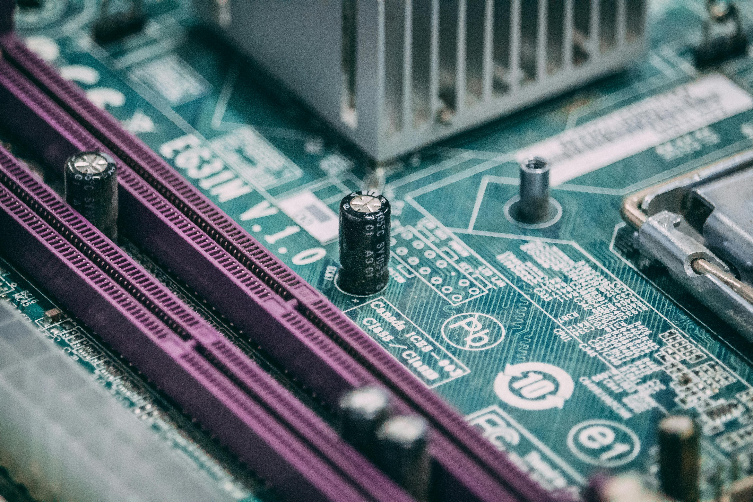

THE IMPORTANCE OF DATA PROTECTION
Data protection refers to the strategies, policies, and legal frameworks put in place to safeguard sensitive, confidential, or private information from unauthorized access, corruption, theft, or loss. In the digital age, data is often considered an organization's most valuable asset and an individual's most private possession, making its defense critical.

Slide 6


CYBER ATTACK TRENDS
The cyber threat landscape is constantly evolving, driven by rapid technological advancements, geopolitical shifts, and the commercialization of cybercrime. Understanding current attack trends helps organizations and individuals anticipate threats rather than merely reacting to them.

Slide 7

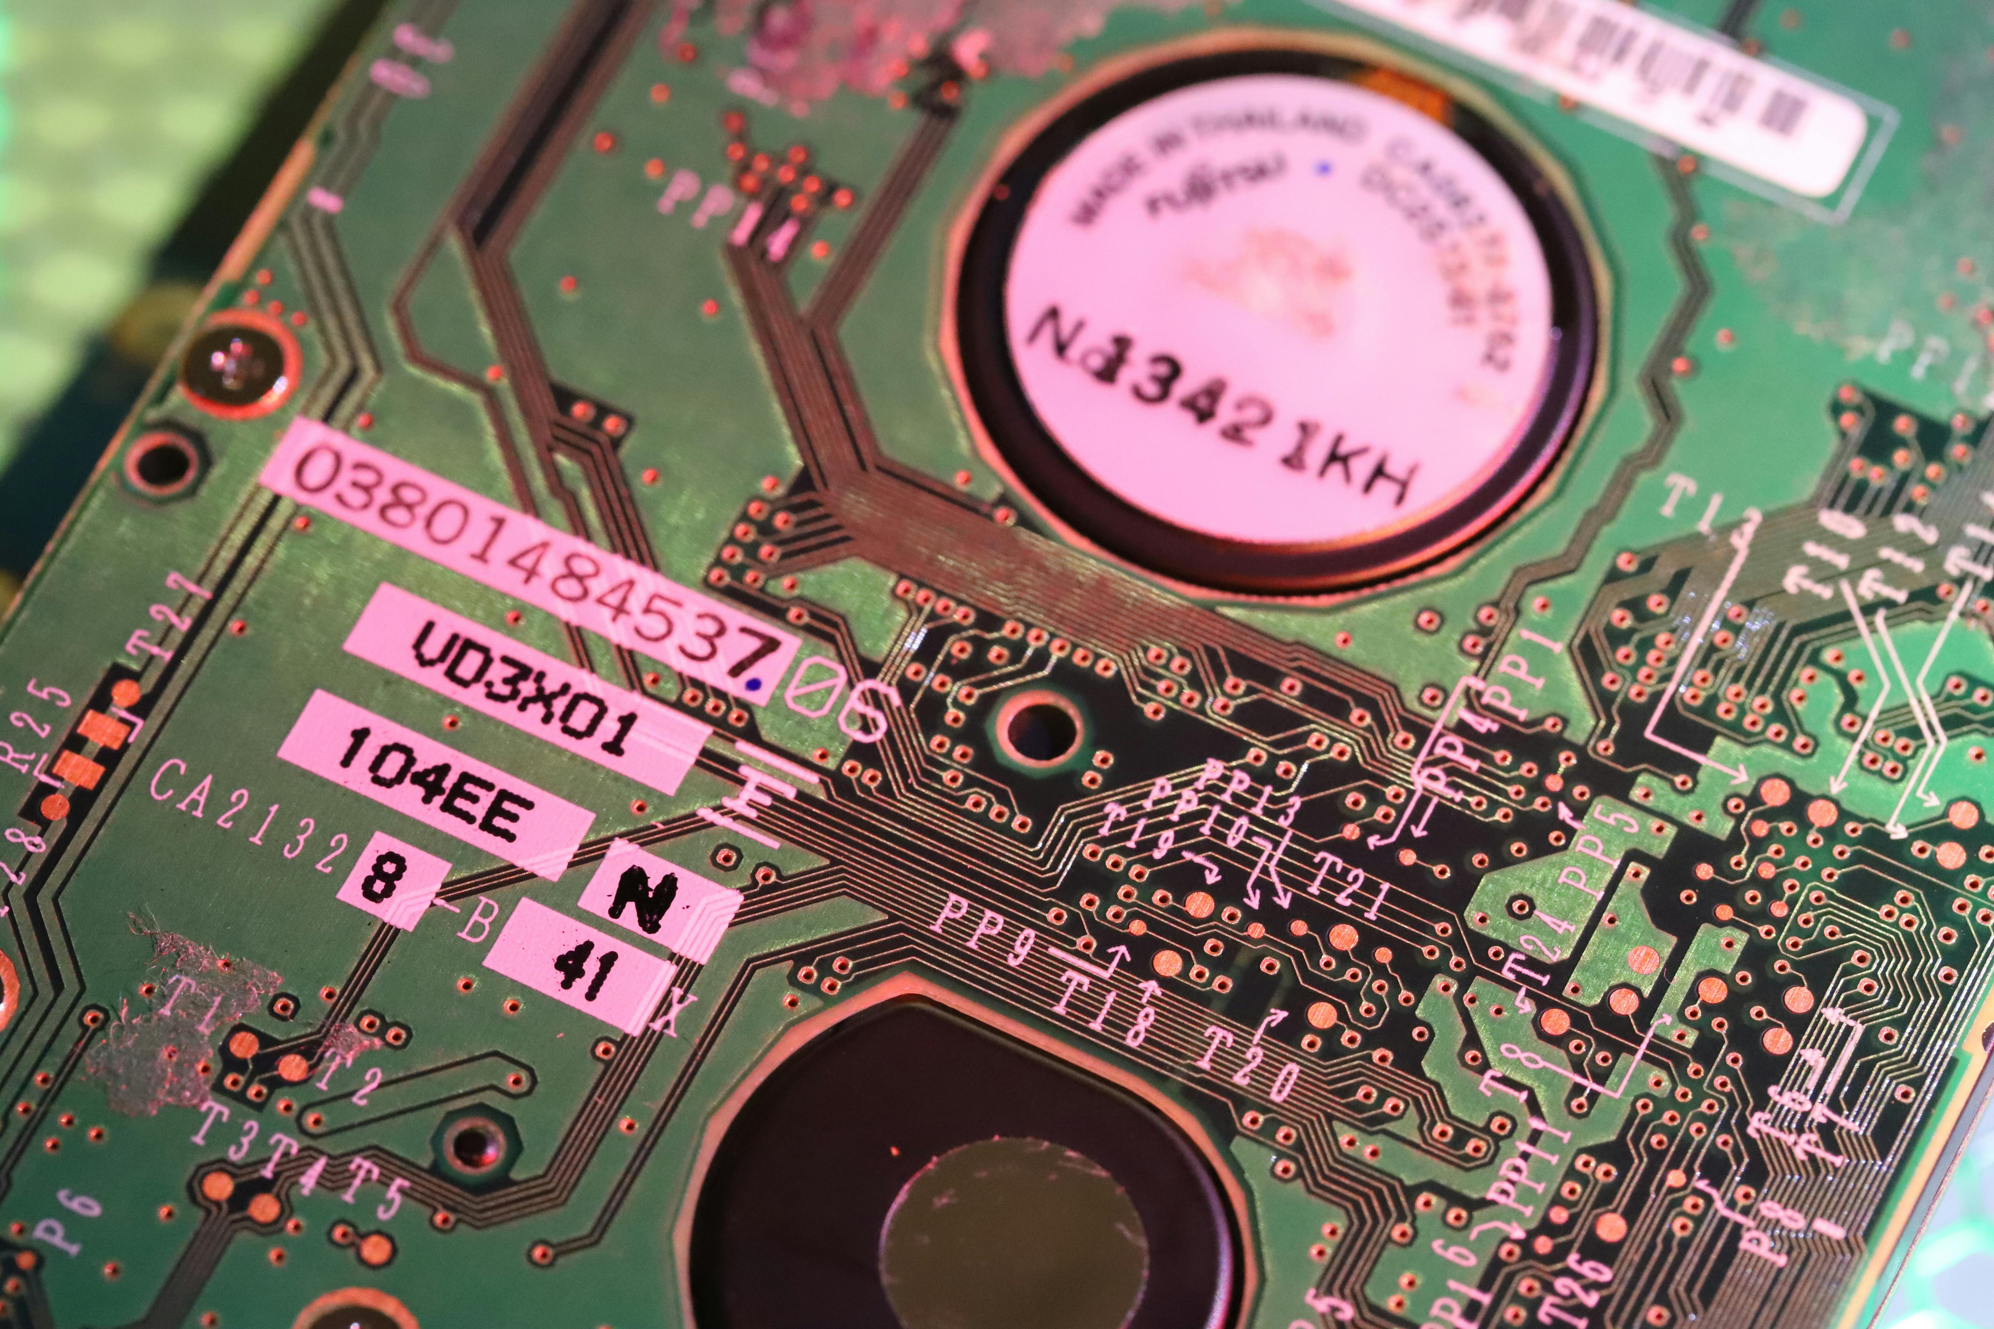
Phishing is one of the most pervasive and successful cyber threats because it targets the human element rather than technical software vulnerabilities. By masquerading as a trusted entity—such as a bank, IT department, colleague, or government agency—attackers manipulate victims into handing over sensitive credentials, financial data, or downloading malicious files.
PHISHING AWARENESS

Slide 8


PASSWORD SECURITY
Passwords remain one of the most common authentication methods used to protect personal and corporate accounts. However, because human memory struggles with complex, unique strings for dozens of different services, weak and reused passwords continue to be a primary entry point for cyber attackers.

Slide 9


NETWORK SECURITY MEASURES
Network security encompasses the hardware, software, and procedural controls designed to protect an organization's infrastructure from unauthorized access, misuse, malfunction, or malicious cyberattacks. Because modern networks are borderless—connecting remote workers, cloud platforms, and IoT devices—securing them requires a multi-layered, defense-in-depth approach.

Slide 10

INCIDENT RESPONSE
An Incident Response (IR) plan is a structured, organized approach to addressing and managing the aftermath of a security breach or cyberattack (referred to as an "incident"). The goal is to handle the situation in a way that limits damage, reduces recovery time, and mitigates future risks, transforming a crisis into a controlled, methodical recovery process.

Slide 11



THANK YOU
SO MUCH

